Slide 1


Differential Reinforcement
Let this image represent the observation of a person at one point in time

Slide 2
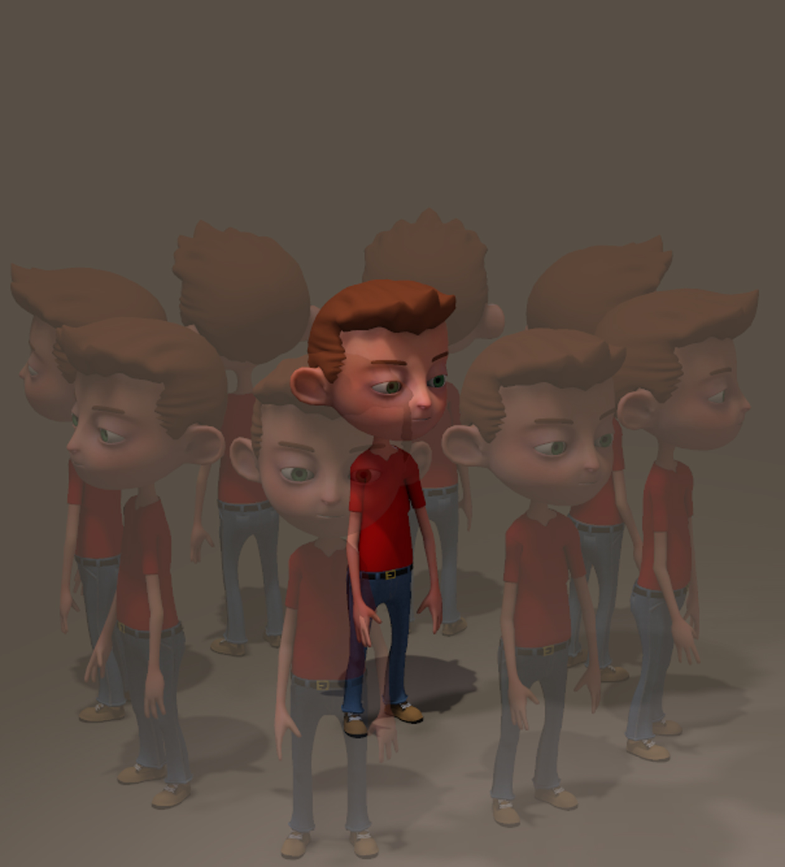
Differential Reinforcement
Let this image represent the variety of behaviour classes that he engages in

Slide 3
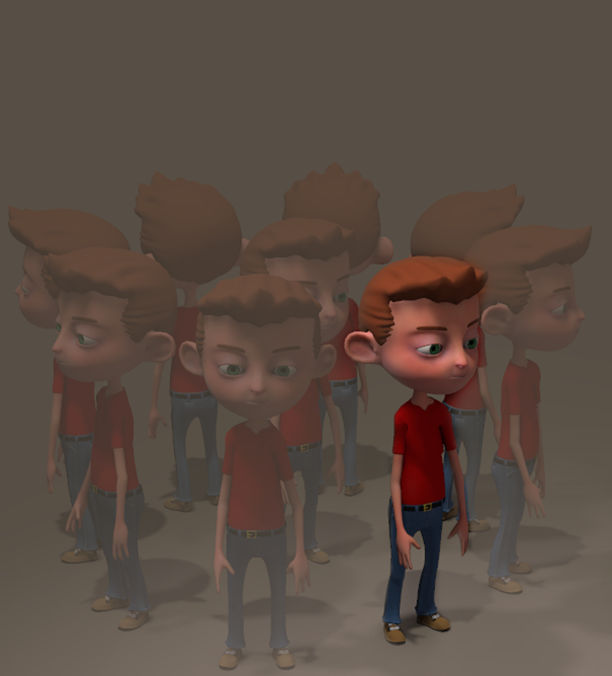
Differential Reinforcement
Let this image represent one of the behaviour classes that has raised concern.
Let’s suppose that in this instance the behaviour occurs too often.

Slide 4
Differential Reinforcement
Ideally, we would want to regulate this behaviour so that it is no longer viewed as a problem.
This is where Differential Reinforcement comes into its own.
The aim is to target the other behaviours to see if they can be used to replace the problem behaviour

Slide 5
Differential Reinforcement
of Incompatible Behaviour
DRI
With this procedure we take advantage of a behaviour that is incompatible with the problem behaviour.
Ideally, the behaviour selected should occur often enough so that there are opportunities for it to be reinforced. Also, it helps if it takes less effort than the problem behaviour.

Slide 6
Differential Reinforcement
of Incompatible Behaviour
DRI
Reinforce this behaviour with the same consequence that is maintaining the problem behaviour
Withhold reinforcement for the problem behaviour

Slide 7
Differential Reinforcement
of Incompatible Behaviour
DRI
Here are links to show some examples of this procedure in action
YouTube
1
2
3
4
5
Managing disruptive behaviour
The effect of differential reinforcement of incompatible behaviors (DRI) on pica for cigarettes in persons with intellectual disability
Improving Behavior through Differential Reinforcement: A Praise Note System for Elementary School Students

Slide 8
Differential Reinforcement
of Alternative Behaviour
DRA
In this procedure we again look at the behaviours in the person’s repertoire and target an alternative to the problem behaviour.

Slide 9
Differential Reinforcement
of Alternative Behaviour
DRA
Unlike the DRI, the alternative behaviour that is selected is not necessarily incompatible with the problem behaviour. As with DRI, reinforcement is withheld for the problem behaviour

Slide 10
Differential Reinforcement
of Alternative Behaviour
DRA
Here are links to show some examples of this procedure in action
YouTube
1
A review of empirical support for differential reinforcement of alternative behavior
An investigation of differential reinforcement of alternative behaviour without extinction
Evaluating treatment challenges with differential reinforcement of alternative behaviour

Slide 11
Differential Reinforcement
DRI/DRA
Can DRI and DRA procedures be used with negative reinforcers?
Of course they can. The two procedures are called
Differential Negative Reinforcement of Incompatible Behaviour (DNRI)
Differential Negative Reinforcement of Alternative Behaviour (DNRA)

Slide 12
Differential Reinforcement
of Other Behaviour
DRO
During DRI and DRA procedures the problem behaviour is basically ignored while another behaviour is reinforced.
In a DRO procedure, a contingency specifies that the problem behaviour must NOT occur for a specified period of time. When this contingency is met, the reinforcer is then delivered.
Essentially, this means that NOT responding is reinforced.

Slide 13
Differential Reinforcement
of Other Behaviour
DRO
Fixed-Interval DRO
Determine the size of the interval you are working with
Start the clock
Deliver the reinforcer at the end of the interval if the problem behaviour did not occur during the interval
Reset the clock if the problem behaviour occurs during the interval

Slide 14
Differential Reinforcement
of Other Behaviour
DRO
Variable-Interval DRO
Determine in advance the variable intervals you are working with
Start the clock
Deliver the reinforcer at the end of each interval if the problem behaviour did not occur during that interval
Reset the clock if the problem behaviour occurs during the interval

Slide 15
Differential Reinforcement
of Other Behaviour
DRO
Fixed-momentary DRO
Variable-momentary DRO
Determine the intervals in advance as in Fixed- and Variable-Interval DRO
Start the clock
Deliver the reinforcer at the end of each interval if the problem behaviour did not occur AT THE END of interval. May be an issue if behaviour occurred during interval; switch to Interval DRO.
Reset the clock if the problem behaviour occurs AT THE END of interval

Slide 16
Differential Reinforcement
of Other Behaviour
DRO
Interval DRO
or
Momentary DRO?
Use Interval DRO to initially suppress behaviour
Use Moment DRO to maintain behaviour that has been suppressed

Slide 17
Differential Reinforcement
of Other Behaviour
DRO
Here are links to show some examples of this procedure in action
YouTube
1
2
3
4
5
A COMPARISON OF TWO PROCEDURES FOR PROGRAMMING THE DIFFERENTIAL REINFORCEMENT OF OTHER BEHAVIORS
The effect of rules on differential reinforcement of other behavior
THERAPIST- AND SELF-MONITORED DRO CONTINGENCIES AS A TREATMENT FOR THE SELF-INJURIOUS SKIN PICKING OF A YOUNG MAN WITH ASPERGER SYNDROME

Slide 18
Differential Reinforcement
of Low Rates of Behaviour
DRL
It may not be appropriate to eliminate a behaviour completely. Instead, one might decide to limit the overall rate at which it occurs.

Slide 19
Differential Reinforcement
of Low Rates of Behaviour
DRL
There are three general procedures:
Full session - during an entire session you monitor the rate of the behaviour. Reinforcement is delivered if the rate meets the specified criterion or if it is lower
Interval - divide an entire session into intervals and monitor the rate of the behaviour in each interval. Reinforcement is delivered in each interval if the rate meets the specified criterion or if it is lower.
Spaced-responding - Rates here are reduced by targeting the time between behaviours; more time between behaviours means the behaviour occurs at a lower rate. That is, an interresponse time (IRT) is determined in advance and reinforcement is delivered when time between behaviours meets this criterion.
DRL procedures are slow to reduce the rate of a behaviour

Slide 20
Differential Reinforcement
of Low Rates of Behaviour
DRL
Here are links to show some examples of this procedure in action
YouTube
1
2
3
4
USING DIFFERENTIAL REINFORCEMENT OF LOW RATES TO REDUCE CHILDREN'S REQUESTS FOR TEACHER ATTENTION
DECREASING CLASSROOM MISBEHAVIOR THROUGH THE USE OF DRL SCHEDULES of REINFORCEMENT
DIFFERENTIALLY REINFORCING LOW RATES OF MISBEHAVIOR WITH NORMAL ELEMENTARY SCHOOL CHILDREN

